Slide 1

Aquarion Water Company
Ponds of Plymouth Water System
Open House
October 2, 2024
City of Derby Wastewater System
Internal Review

Slide 2
Aquarion is committed to providing high-quality water to our valued customers in the Ponds of Plymouth
John Walsh, VP, Operations (MA&NH), Water Quality, Environmental Management
Yesher Larsen, Director, Water Quality
Sarah Trejo, Water Quality Compliance Coordinator
Andrea Millard, Director, Customer Services
April Burggraf, Manager, Customer Experience
Martina LaMarca, Customer Advocate
Rob Kehlhem, Water System Field Operator
Sean Sullivan, Utility Worker
George Logan, Director of Community Relations (Moderator)

Slide 3
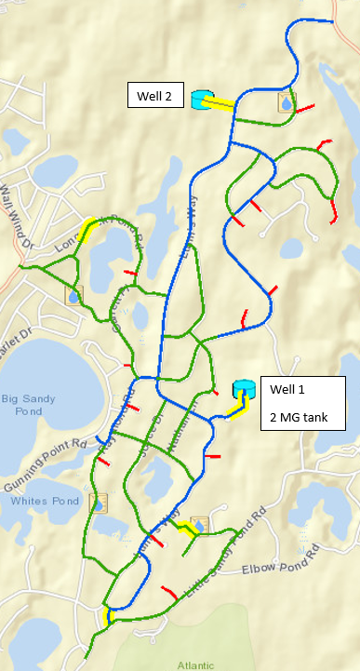
System Infrastructure / Assets
Two wells, each with water treatment facilities
2 million gallon water storage tank at Well 1
Booster pump station at Well 1
15 miles of water main
841 service connections
147 hydrants

Slide 4
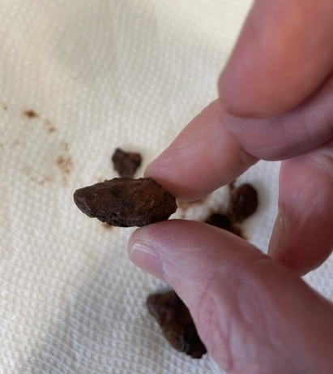
Cause of Discolored Water
Naturally occurring manganese (Mn) and iron (Fe) in the well waters are the cause of discolored water.
Evidence of years of accumulation and build-up of manganese and iron on the inside of the water mains.
Build-up is shedding off and causing discoloration.
Particularly when flow through pipes increases or changes direction, these accumulated minerals can be disturbed and discolor the water.
Chlorination that began in May 2023 may be accelerating this shedding.

Slide 5
Aquarion actions
Evaluations
Investigated potential sources of discoloration (including testing of iron and manganese levels from sample stations we added throughout the system)
Inspected water storage tank
Observing water quality through sampling in distribution system
System-Wide Flushing
System-wide flushing of the water mains - Nov '23, May '24, and Sept '24
Involves controlled hydrant flushing to remove sediments and build-up from our mains
Flushing typically performed once per year in water systems
With evidence of build-up inside the mains, we've increased the flushing frequency
MassDEP states that flushing is critical to the overall maintenance of a distribution system and is one of the most important practices carried out by public drinking water systems to maintain high water quality, improve the carrying capacity of pipes, and ensure proper operation of distribution system components, such as hydrants and valves. To learn more, visit MassDEP's Water Main Flushing FAQ for Consumers.

Slide 6
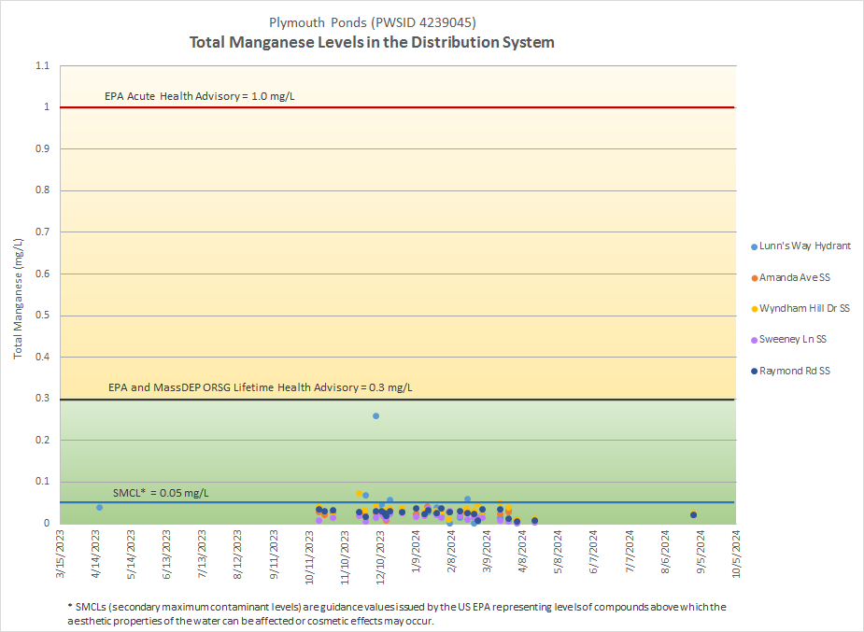
Manganese (Mn) Concentrations
Mn concentrations in the water in the distribution system are well below health advisory levels defined by health regulators (USEPA and MassDEP), and generally below the aesthetic limit referred to as the Secondary Maximum Contaminant Level.

Slide 7
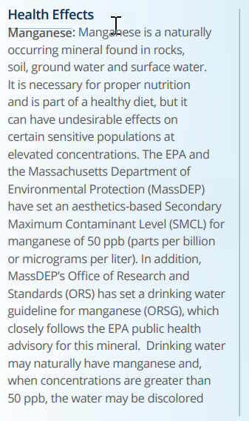
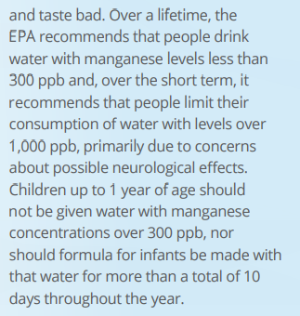
Manganese Information
From the 2023 Water Quality Report (aka Consumer Confidence Report) for Ponds of Plymouth water system.
https://www.aquarionwater.com/water-quality/water-quality-reports/ma-water-quality-reports

Slide 8
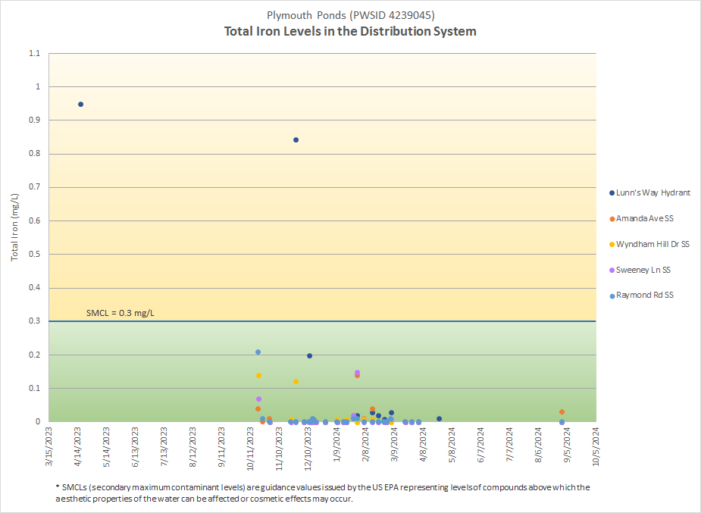
Iron (Fe) Concentration
Iron concentrations in the water in the distribution system are well below the aesthetic limits referred to as the Secondary Maximum Contaminant Level. There are no health advisory levels for iron defined by health regulators.

Slide 9
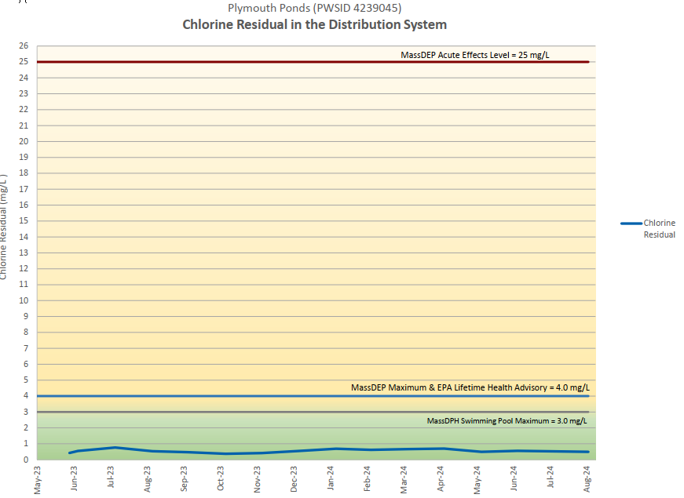
Purpose of Chlorination
Detected coliform bacteria in the water in four months in 2022. Coliform bacteria was also detected seven times between 2017 and 2021. This indicates a bacteriological risk. Most reliable approach to addressing this risk is chlorination.
Chlorination is a standard practice and is one of the most important advances in public health protection. Chlorine kills harmful microorganisms that can cause disease and immediate illness.
Chlorine levels are well below the maximum level allowed by MassDEP.

Slide 10
Aquarion Actions – Moving Forward
System-wide flushing at least twice per year until build-up is removed.
Continue testing iron and manganese levels. Information will be available on MassDEP website.
Add sample hydrants, particularly in central part of system. Will simplify our continued testing of water quality throughout the system.
Perform complete discoloration study to document findings to-date, fully evaluate composition of build-up, identify risks (for example, further/future build-up), and develop solutions to mitigate risks.

Slide 11
Q&A
Aquarion is here to answer your questions, open communications, and build a partnership with you
John Walsh, VP, Operations (MA&NH), Water Quality, Environmental Management
Yesher Larsen, Director, Water Quality
Sarah Trejo, Water Quality Compliance Coordinator
Andrea Millard, Director, Customer Services
April Burggraf, Manager, Customer Experience
Martina LaMarca, Customer Advocate
Rob Kehlhem, Water System Field Operator
Sean Sullivan, Utility Worker
George Logan, Director of Community Relations (Moderator)

